Slide 1
Off-Path TCP Sequence Number Inference Attack--How Firewall Middleboxes Reduce Security
S&P 2012
Zhiyun Qian, Z. Morley Mao

Slide 2
Contents
1
Issue
2
Related Work
3
Scheme
4
Experiment
5
Conclusions

Slide 3
Issue
TCP designed without many security considerations
One of the critical patches: randomization of TCP initial sequence numbers(ISN)
Firewall vendors: sequence number checking at
network-based firewalls(31.5% out of 149)
Ironically, the feature in fact allows an attacker to determine the valid sequence number

Slide 4
Related Work
TCP-sequence-number-related attacks
Sequence number prediction attack
Certain Oses select the TCP ISN based on a global
counter
Blind TCP RST attack
the attack is possible because a reset (RST) packet is
accepted as long as its sequence number falls within
the current TCP receive window
Sequence number inference attack
first described in 1999,Linux 2.0.X kernel has a bug:
it drops the packet when the ACK number is too
small, sends a reset when ACK is big

Slide 5
Our Aim
Using the sequence number inference as a building block, we design and implement a number of attacks including TCP hijack on mobile networks

Slide 6
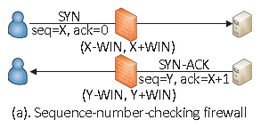
Scheme
A. Sequence-Number-Checking Firewalls
All major vendors including Cisco , Juniper, and Check Point have such products

Slide 7
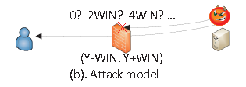
Scheme
A. Sequence-Number-Checking Firewalls
infer the sequence number, due to the behavior that the firewall treats packets with in-window and out-of-window sequence numbers differently

Slide 8
Scheme
B. Obtaining Four Tuples – Threat Model
(1). On-site TCP injection/hijacking
An unprivileged malware runs on the client with access to network
(2). Off-site TCP injection
An attacker simply guesses the four tuples
(3). Establish TCP connection using spoofed IPs
An attacker initiates the connection himself, four tuples are obviously known

Slide 9
Scheme
C. Obtaining Feedback – Side Channels
1.OS packet counters:
some of the TCP error counters rarely increment under normal conditions and can be leveraged as a clean side channel
2. IPIDs from responses of intermediate middleboxes:
In practice, many OSes(including middlebox OSes) have monotonically incrementing IPIDs
intermediate middleboxes (e.g., routers) to reply with “time-to-live (TTL) expired” ICMP messages

Slide 10
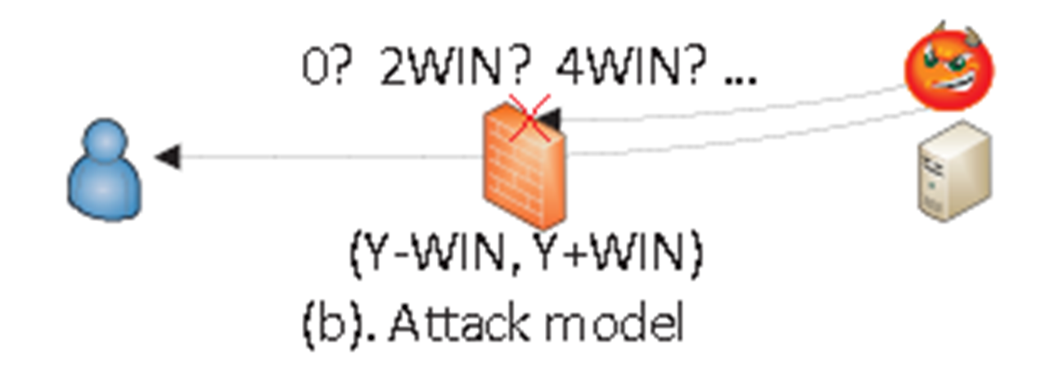
Scheme
D. Sequence Number Inference
Naïve approach: test out each individual window sequentially

Slide 11
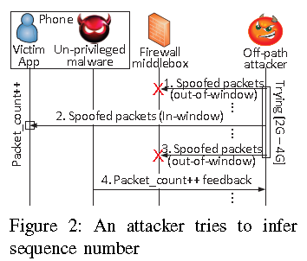
Scheme
D. Sequence Number Inference
Our approach–—— a binary-search-like inference

Slide 12
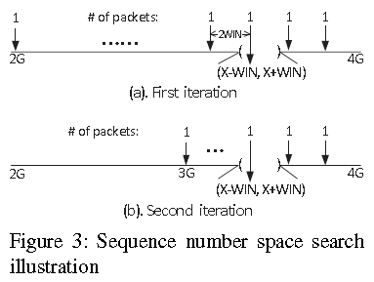
Scheme
D. Sequence Number Inference
Our approach–—— a binary-search-like inference

Slide 13
Scheme
E. Timing of Inference and Injection — TCP Hijacking
a critical challenge is timing

Slide 14
Scheme
Attack Design
1） On-site TCP hijacking
Reset-the-server
The high-level idea is to reset the connection on the legitimate server as soon as possible to allow the attacker to claim to be the legitimate server talking to the victim

Slide 15
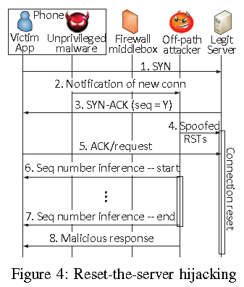
Scheme
Attack Design
1） On-site TCP hijacking
Reset-the-server
The key is that such reset packets have to be triggered right after the legitimate server sends SYN-ACK

Slide 16
Scheme
Attack Design
1） On-site TCP hijacking
Preemptive-SYN
it turns the firewall middlebox’s sequence number checking feature against the legitimate server

Slide 17
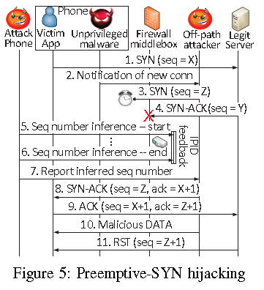
Scheme
Attack Design
1） On-site TCP hijacking
Preemptive-SYN

Slide 18
Scheme
Attack Design
1） On-site TCP hijacking
Hit-and-run
This attack is possible only when the network deploys two different firewall middleboxes

Slide 19
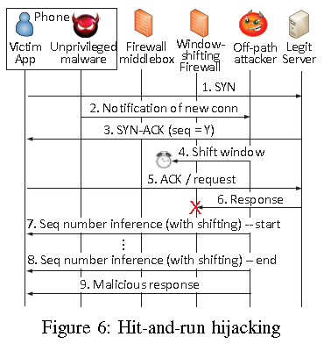
Scheme
Attack Design
1） On-site TCP hijacking
Hit-and-run

Slide 20
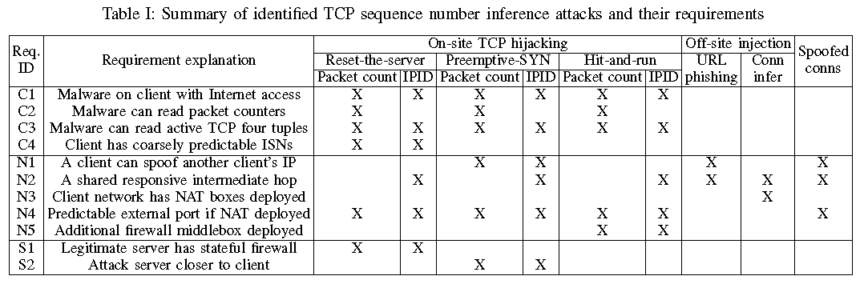
Scheme
Requirements

Slide 21
Scheme
Attack Design
2） Off-site TCP injection/hijacking:
URL phishing
assuming the user visited the malicious webpage, the attacker can obtain the client/website’s IP. But when NAT is deployed, the attack requires client’s private IP in order to conduct the ISN from the client’s network

Slide 22
Scheme
Attack Design
2） Off-site TCP injection/hijacking:
Long-lived connection inference
This attack is possible because NAT boxes maintain state about active or in-session TCP connections, identified by four tuples

Slide 23
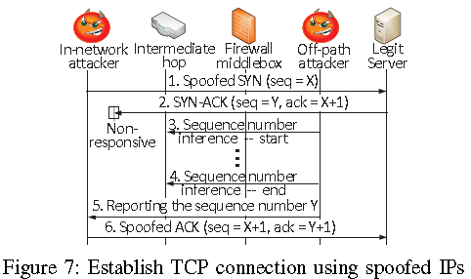
Scheme
Attack Design
3） Establish spoofed connections:
The goal of this attack is to establish TCP connections to a legitimate server from an attacker using spoofed IPs

Slide 24
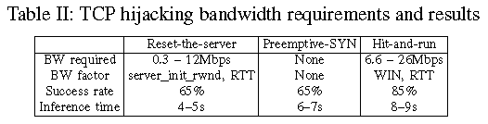
Experiment
Client platform: OS versions of Android 2.2 and 2.3.4 and from three vendors (HTC, Samsung, and Motorola)
Network: deploys firewall middleboxes at the GGSN-level. The carrier satisfied all the network-side requirements (N1 to N4)

Slide 25
Conclusion
They discover and report the TCP sequence number inference attack enabled by firewall middleboxes
leveraging it as a building block to achieve TCP hijacking and a number of other attacks

Slide 26
Thank You !

